Slide 1
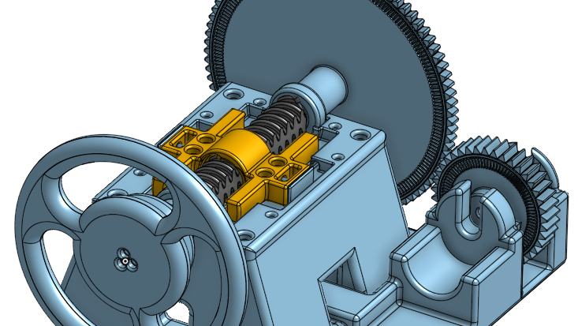
Development of a Steer-by-Wire demonstration facility
Researcher: Masase Netshituka Supervisor: Prof. Azeem Khan
Notes:
Less text

Slide 2
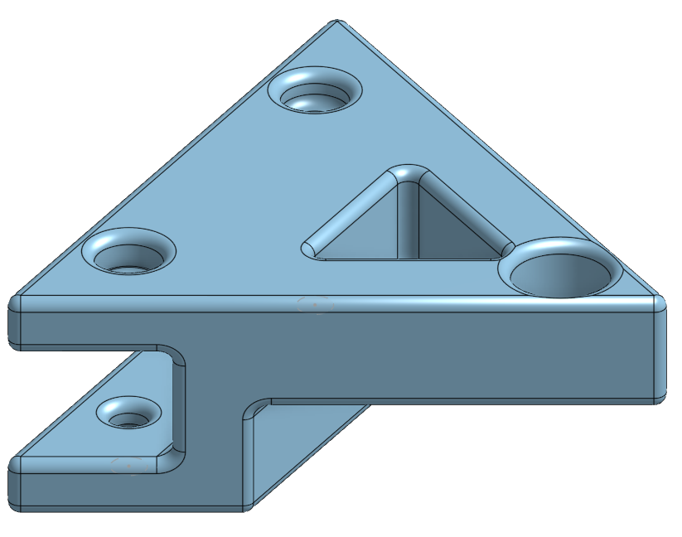
Project background
Steer-by-Wire(SBW) is an emerging technology based on the evolution of steering mechanisms.
The tech is based on EPAS systems.
SBW removes the mechanical link between the steering wheel and axle entirely.
Purpose of this project is to develop an interactive and educational model for demonstration.

Slide 3
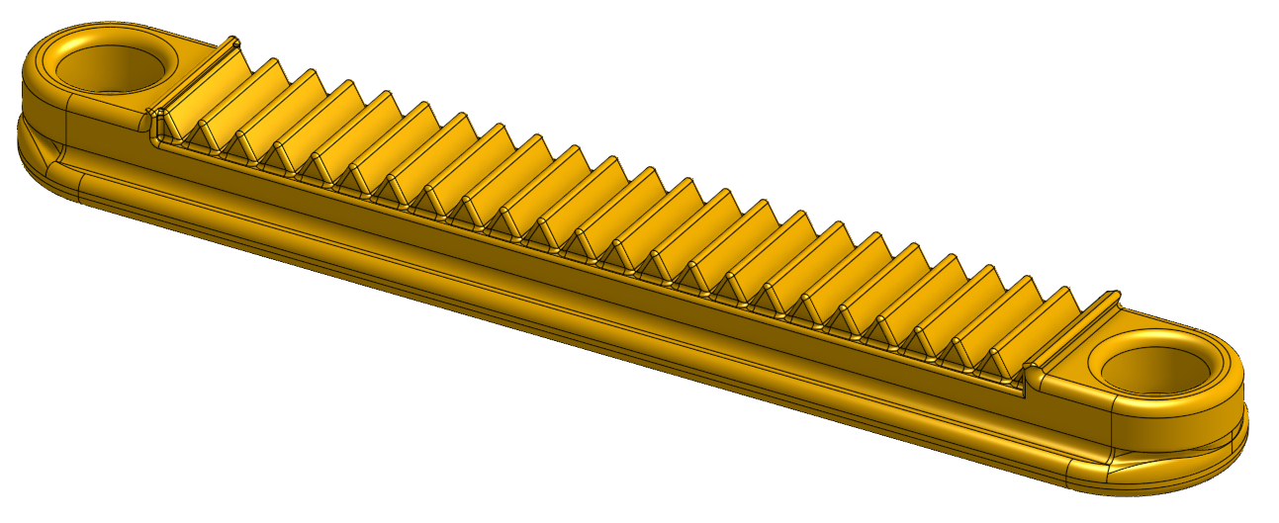
Research
Current systems
Steer-by-Wire
Common steering systems:
Synchronous steering
Rack-and-Pinion
Different Power Assisted Steering (PAS) systems:
Hydraulic power steering (HPAS)
Electro-hydraulic power steering (EHPAS)
Electric power steering (EPAS)
Advantages:
Highly flexible design
Highly efficient
Easy to integrate
Increased crash safety
Highly tailored experience
Disadvantages:
Highly complex
Reliability concerns
High initial implementation cost
Notes:
Advanced driver assistance system

Slide 4
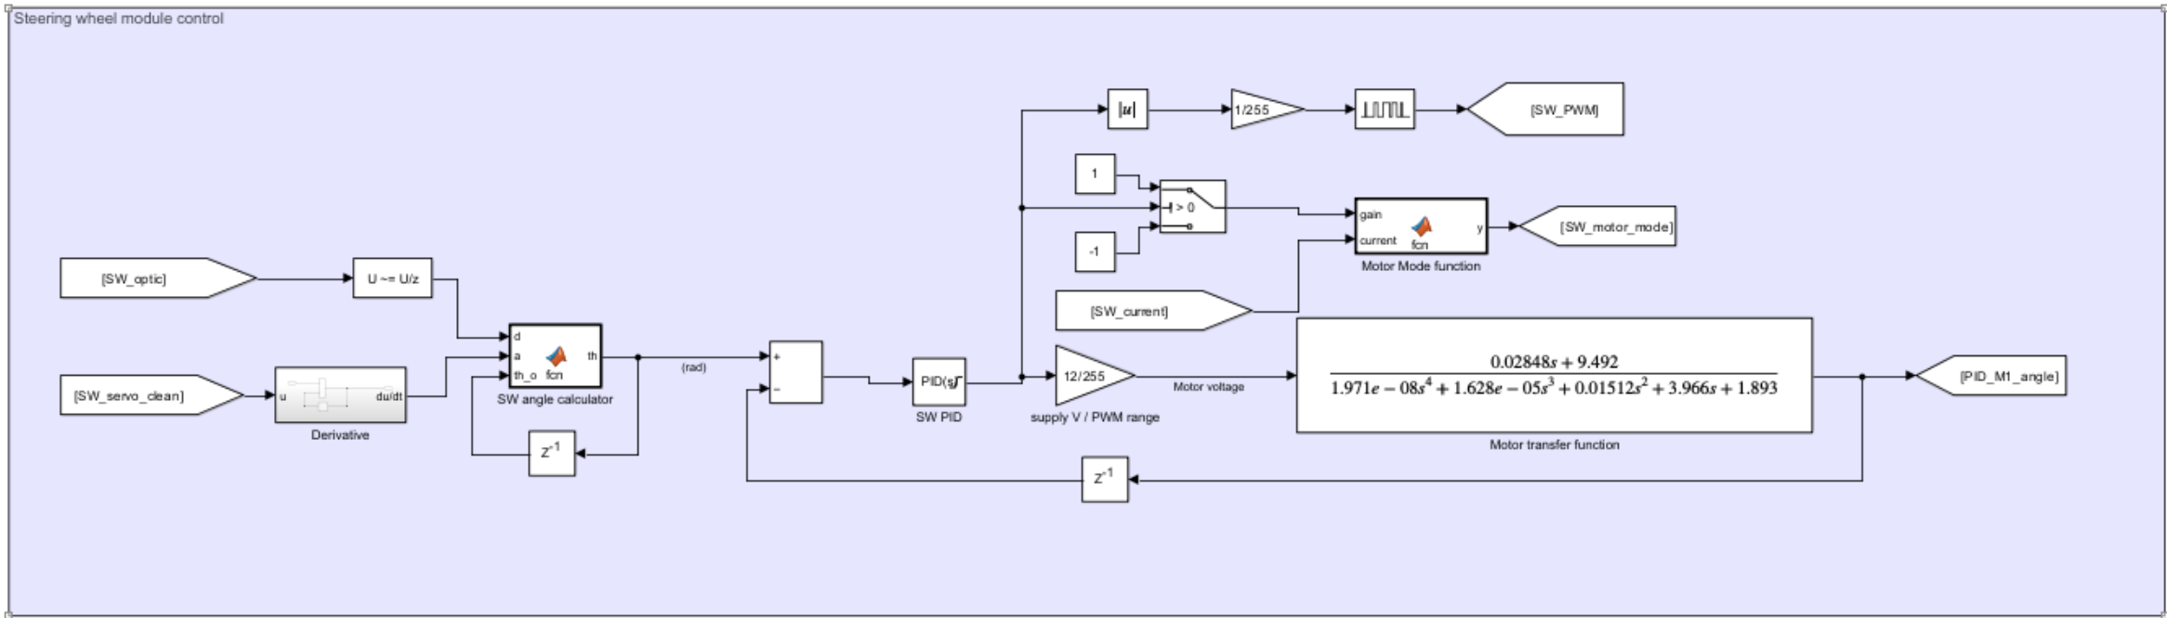
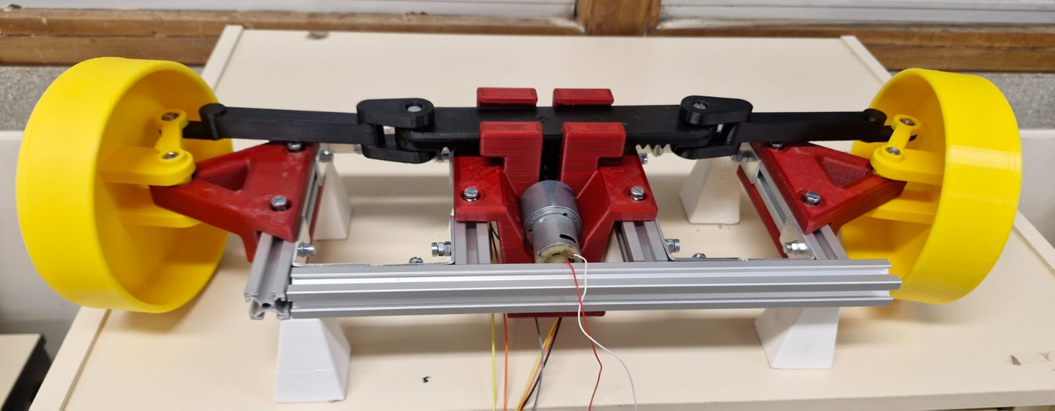
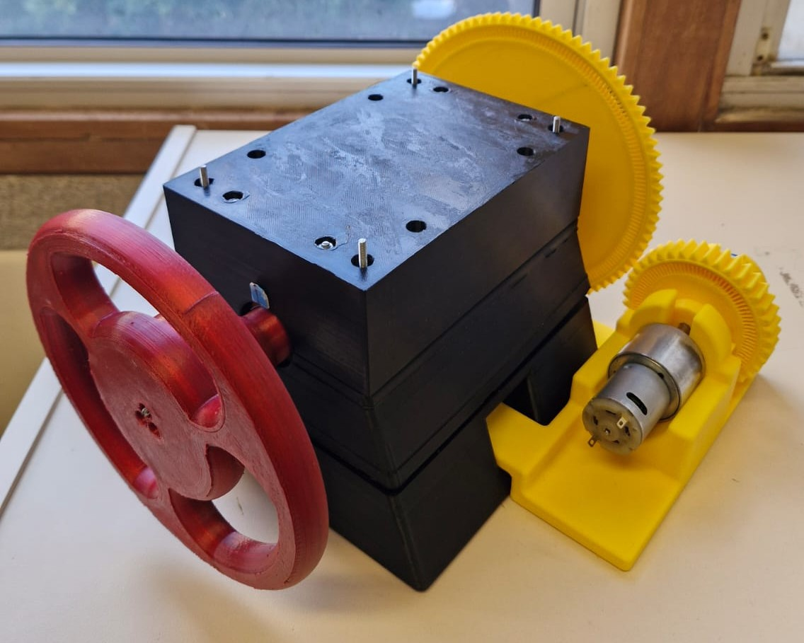
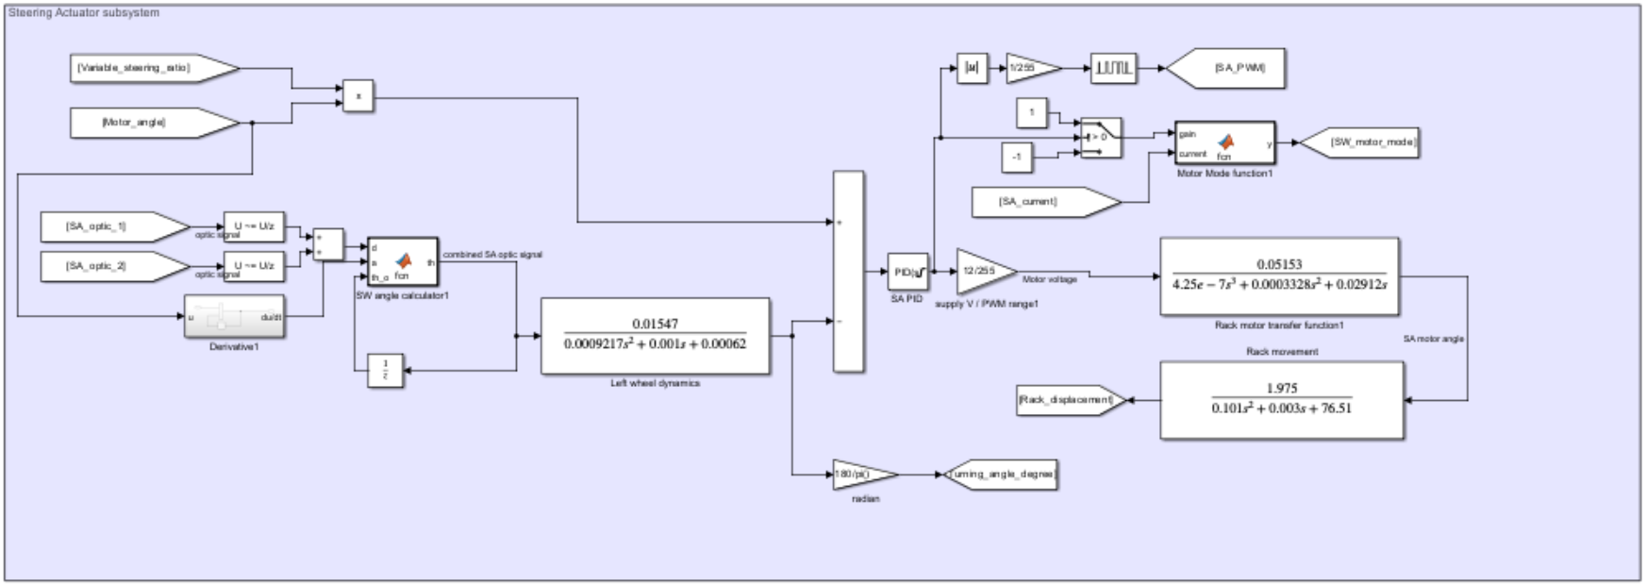
Model development

Slide 5
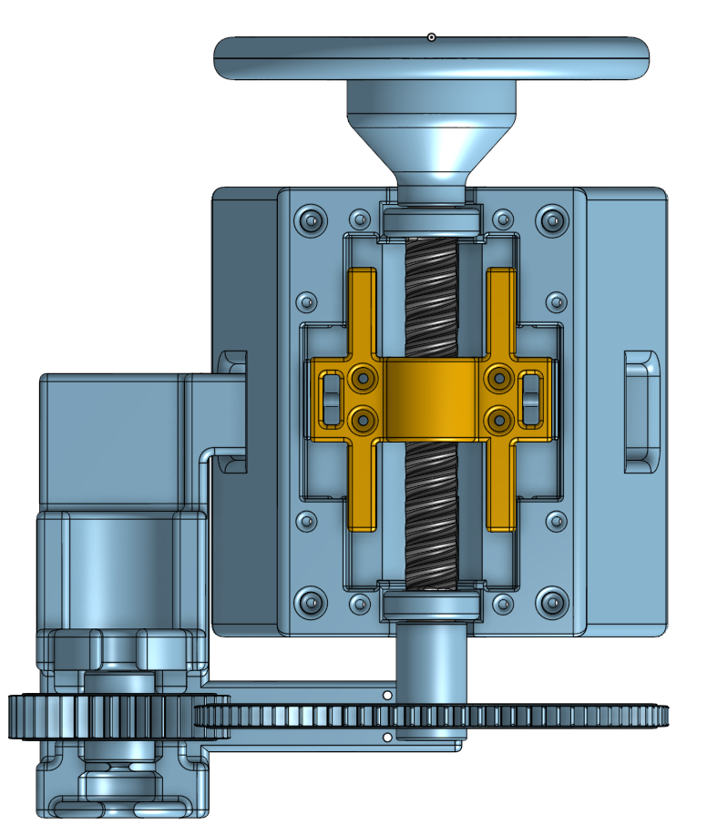
Steering Wheel module design
Design objectives:
720° Steering range
Durable design
Recentring system
± 1° steering angle resolution
120 rpm wheel rotation
Design components:
End-stop housing system
Self-centring mechanism
Custom rotary encoder
potentiometer
2.3 : 1 gearing ratio with 12V 270rpm motor
Notes:
Mention that feedback torque was not implemented Add SW as actual image, not background

Slide 6
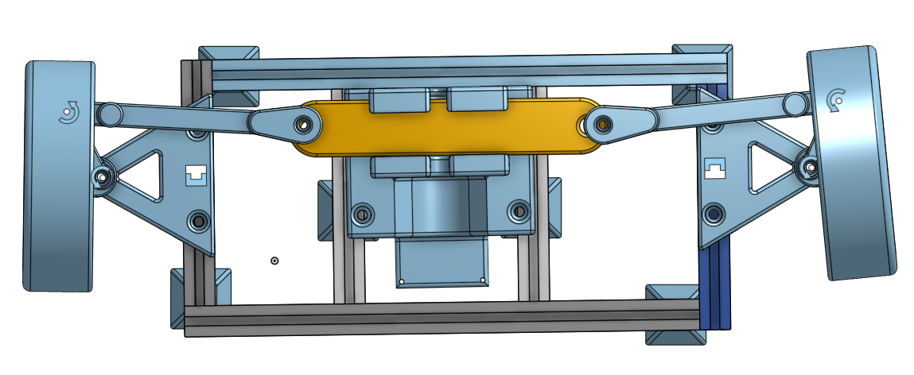
Steering Actuator module design
Design objectives:
Design components:
46,42° ± 4,6° Turning range
End-to-end turn in 1s
Ackermann theory fulfilment
± 1° steering angle resolution
Small scale
Rack-and-pinion base design
60rpm motor
Grey-code rotation direction
1:3 scale of Suzuki Fronx
Notes:
Bring image to the front

Slide 7
ECU and Control
Design objectives:
Smooth steering response
< 2s delay in response
<5% transient state overshoot
Hardware:
Arduino Uno microcontroller
4 Quadrant drivers
Use of MATLAB/SMULINK
PID based control
Software:
EOMs derived and converted into transfer functions
PID based control methodology
2 loop system:
Steering wheel module
Steering Actuator module

Slide 9
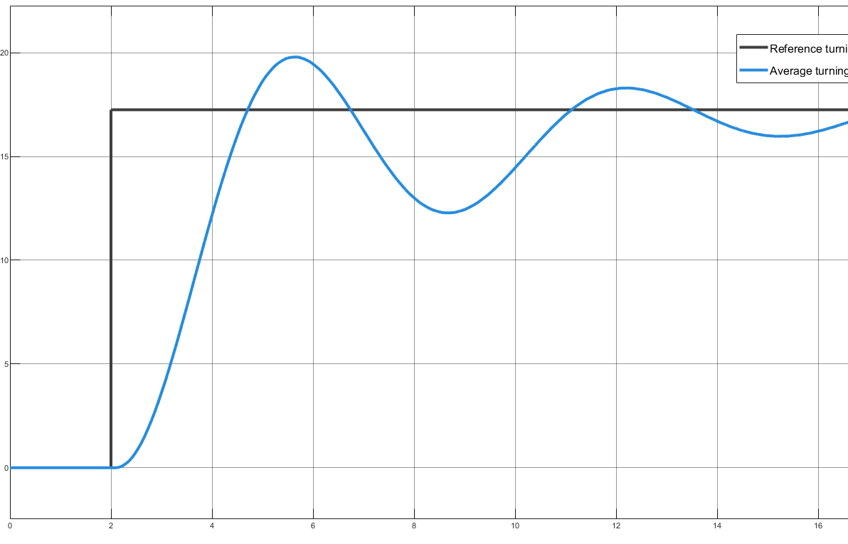
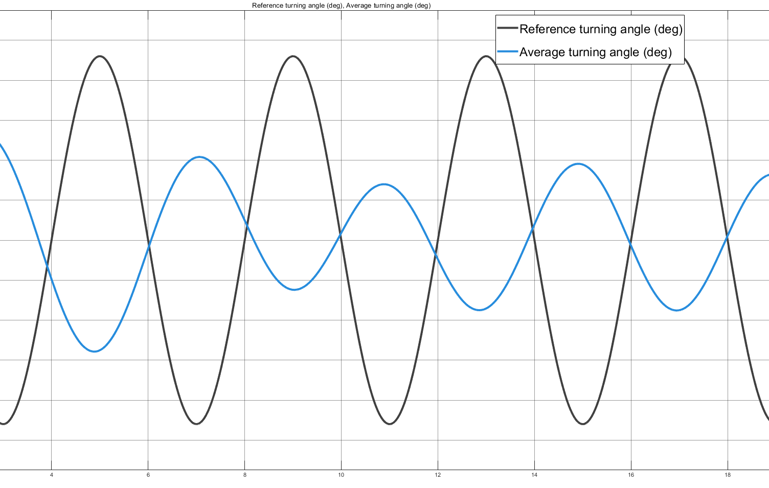
Results
Step response
System tracked with a damped step with 5,2s, sinusoid in1,4s delay
Steering range of 52° (11,2%)
Ackermann criteria upheld
Custom encoder system functioned, but faced precision issues
Full-range steering in 1s achieved.
Recentering system faced challenges
Stronger springs
Refined steering shaft thread angle
475 mm x 545 mm overall dimensions
0,25Hz sinusoid response
Notes:
Put heading for graphs

Slide 10
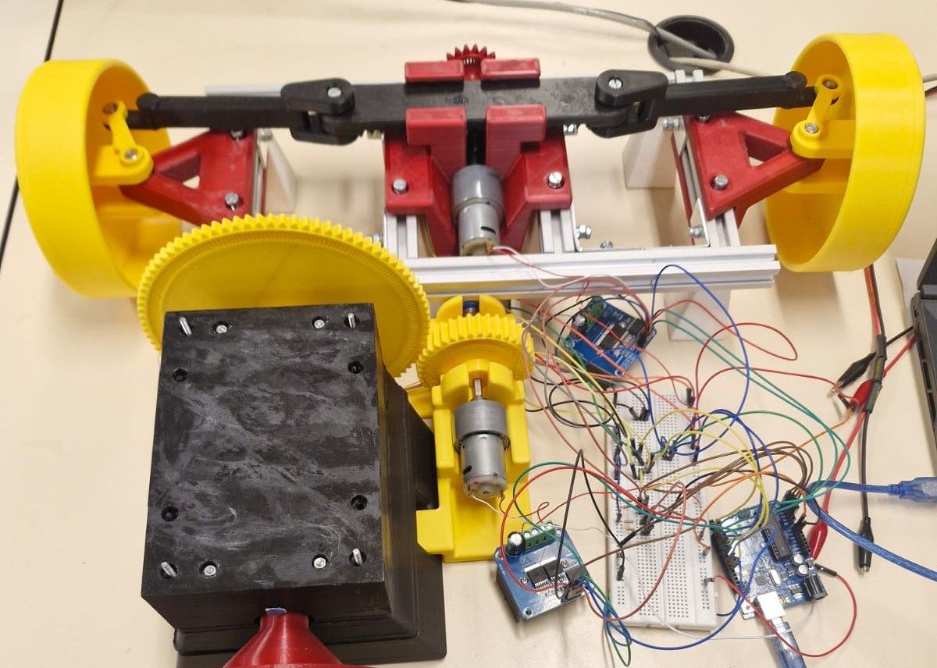
Recommendations
Conclusion
Design is a functional display and representation of the SBW system, despite the challenges faced.
Core principles of SBW and rack-and-pinion steering are evident with wireless steering communication achieved.
Larger spring constant
Improved shaft thread design
Recalculation of rack and tie-rods
Implementation of Feedback torque
Microcontroller with more memory

Slide 11
THANK YOU

